Slide 1
OSI Model Layers
Tasmia Jannat
Lecturer, Dept of CSE, RUET

Slide 2
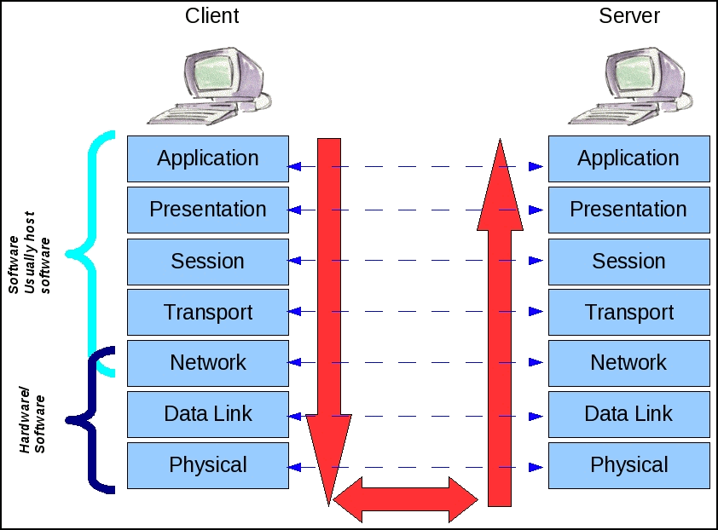
OSI Model Introduction
The Open Systems Interconnection (OSI) model describes seven layers that computer systems use to communicate over a network.
It describes how information from a software application in one computer (client) moves through a physical medium to the software application in another computer (Server).
Open System? OSI means that there's no fix host and server. It is open to all networking devices, which means any one could use the internet.

Slide 3
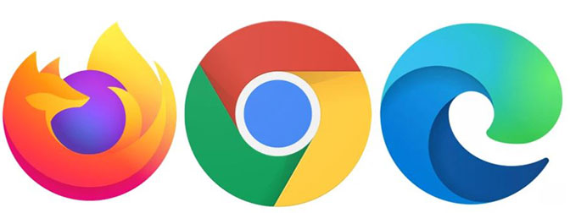
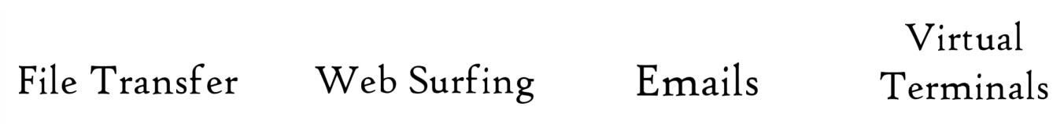
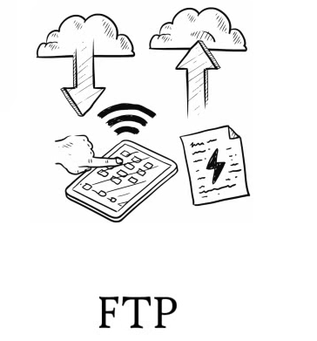


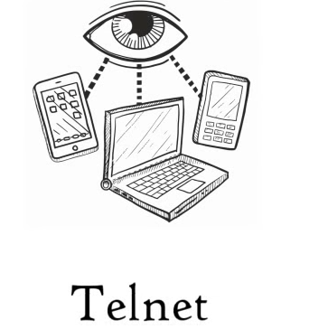
OSI Model Layers
Application
Application Layer:
Non-tech term: is about user’s application
Tech Term: Application layer protocols:
Presentation
Session
Transport
Network
Data Link
Physical Layer
All People Should Try New Data Path

Slide 4
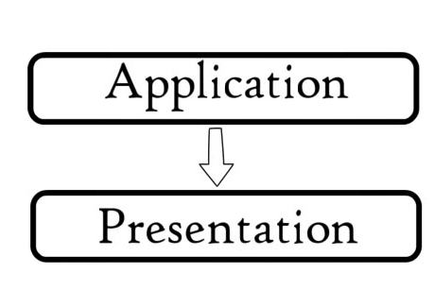
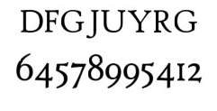
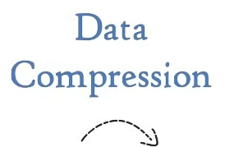






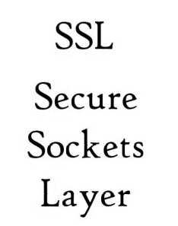
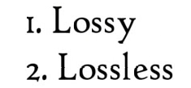
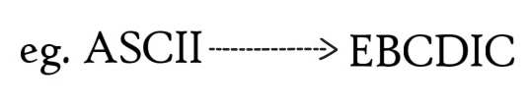
OSI Model Layers
Presentation Layer: The presentation layer provides a variety of coding and conversion functions on application data. These functions ensure that information sent from the application layer of the client would be understood by the application layer of the server.
Application
Presentation
Session
Transport
Network
Data Link
Physical Layer
This layer tries to translate application data into a certain format that every different system could understand.

Slide 5
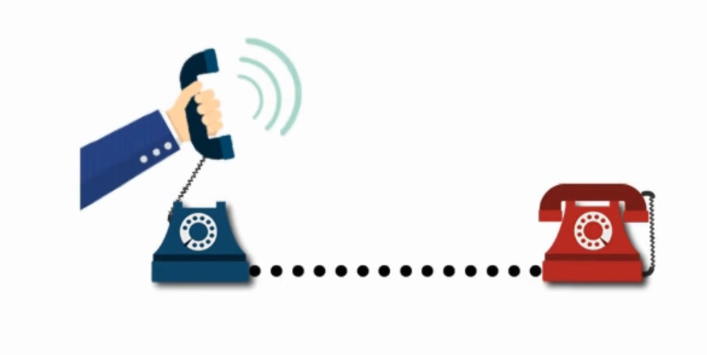
OSI Model Layers
Session Layer:
Main Function:
To establish
Manage
And terminate
Connections between the sender and the receiver
The session layer can also set checkpoints during a data transfer—if the session is interrupted, devices can resume data transfer from the last checkpoint.
Transport Layer
The transport layer takes data transferred in the session layer and breaks it into “segments” on the transmitting end.
This layer can be termed as an end-to-end layer as it provides a point-to-point connection between source and destination to deliver the data reliably.
Controls the reliability of communication through segmentation, Flow control and Error control.
Application
Presentation
Session
Transport
Network
Data Link
Physical Layer

Slide 6
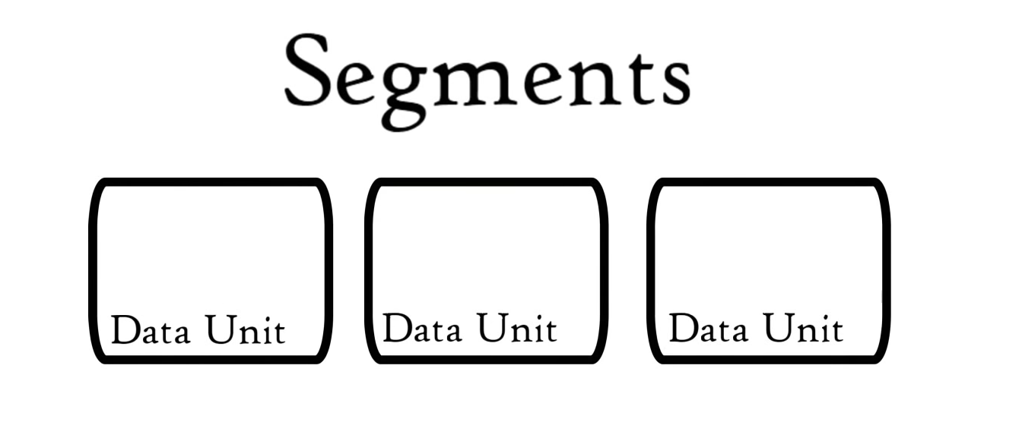
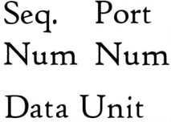
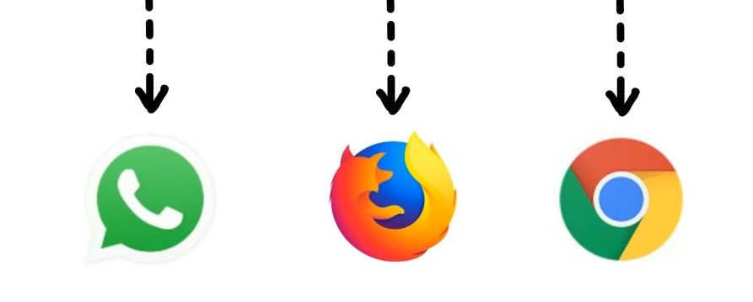
OSI Model Layers
Transport Layer
Controls the reliability of communication through segmentation, Flow control, and Error control.
Segmentation:
Application
Presentation
Session
Transport
Network
Data Link
Physical Layer
Port Number helps to direct each segment into the correct application.
Sequence Numbers help to reassemble segments into the correct sequence.

Slide 7
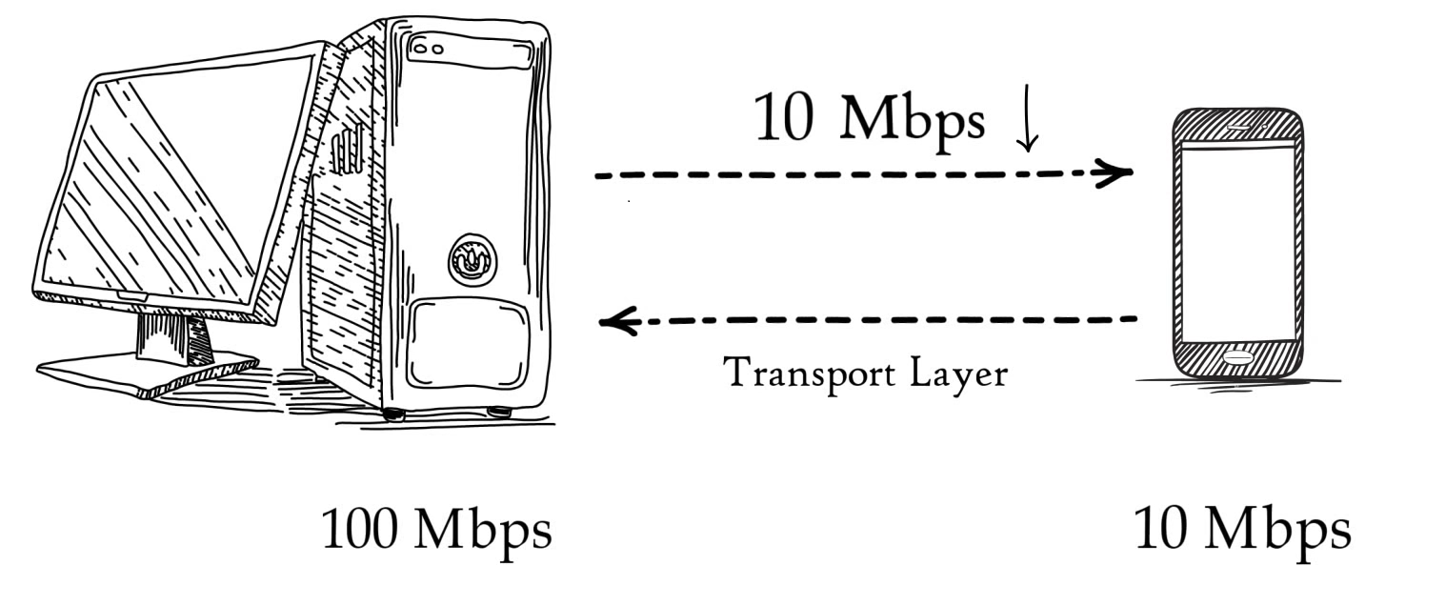
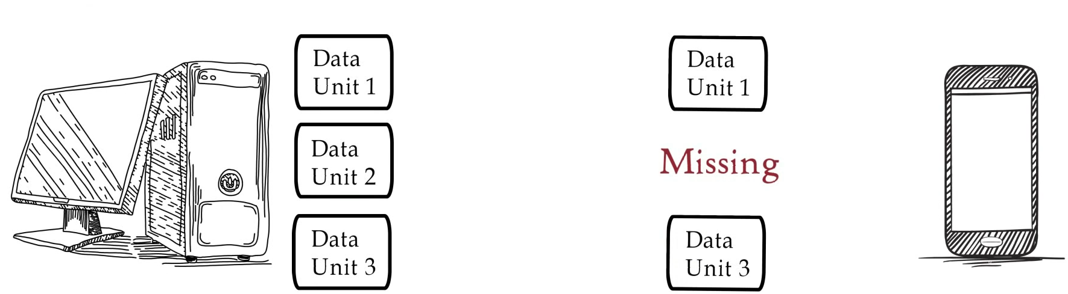

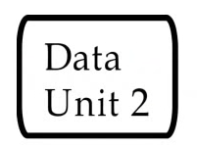

OSI Model Layers
Transport Layer
Controls the reliability of communication through segmentation, Flow control, and Error control.
Flow Control:
Error Control:
Application
Presentation
Session
Transport
Network
Data Link
Physical Layer

Slide 8
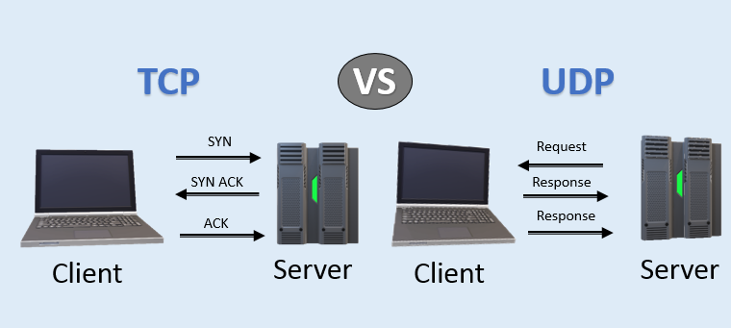
OSI Model Layers
Transport Layer
The two protocols used in this layer are:
Transmission Control Protocol (TCP)
User Datagram Protocol (UDP)
Application
Presentation
Session
Transport
Network
Data Link
Physical Layer

Slide 9
OSI Model Layers
Transport Layer
The two protocols used in this layer are:
Transmission Control Protocol (TCP)
It is a standard protocol that allows the systems to communicate over the internet.
It establishes and maintains a connection between hosts.
When data is sent over the TCP connection, then the TCP protocol divides the data into smaller units known as segments. Each segment travels over the internet using multiple routes, and they arrive in different orders at the destination.
The transmission control protocol reorders the packets in the correct order at the receiving end.
User Datagram Protocol (UDP)
User Datagram Protocol is a transport layer protocol.
It is an unreliable transport protocol as in this case receiver does not send any acknowledgment when the packet is received, the sender does not wait for any acknowledgment. Therefore, this makes a protocol unreliable.
Application
Presentation
Session
Transport
Network
Data Link
Physical Layer

Slide 10
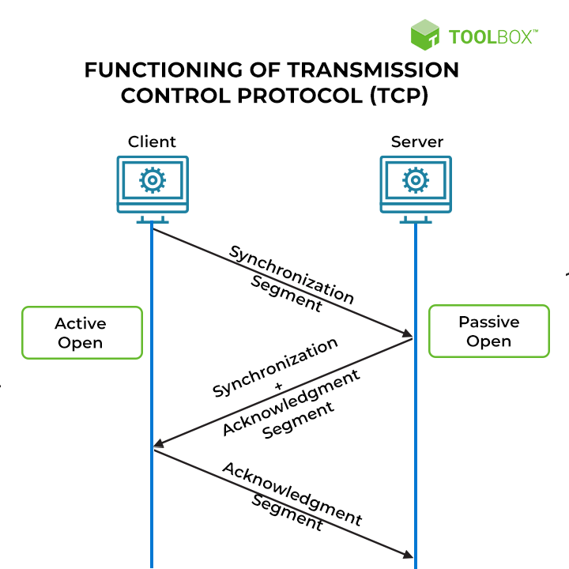
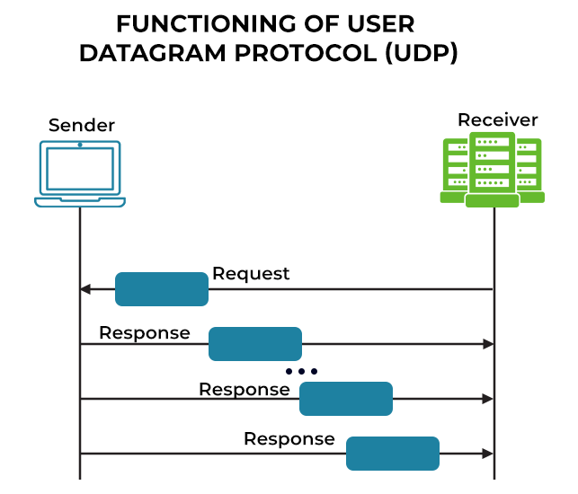
TCP relies on a three-way handshake (synchronization, synchronization acknowledgment, and final acknowledgment)

Slide 11
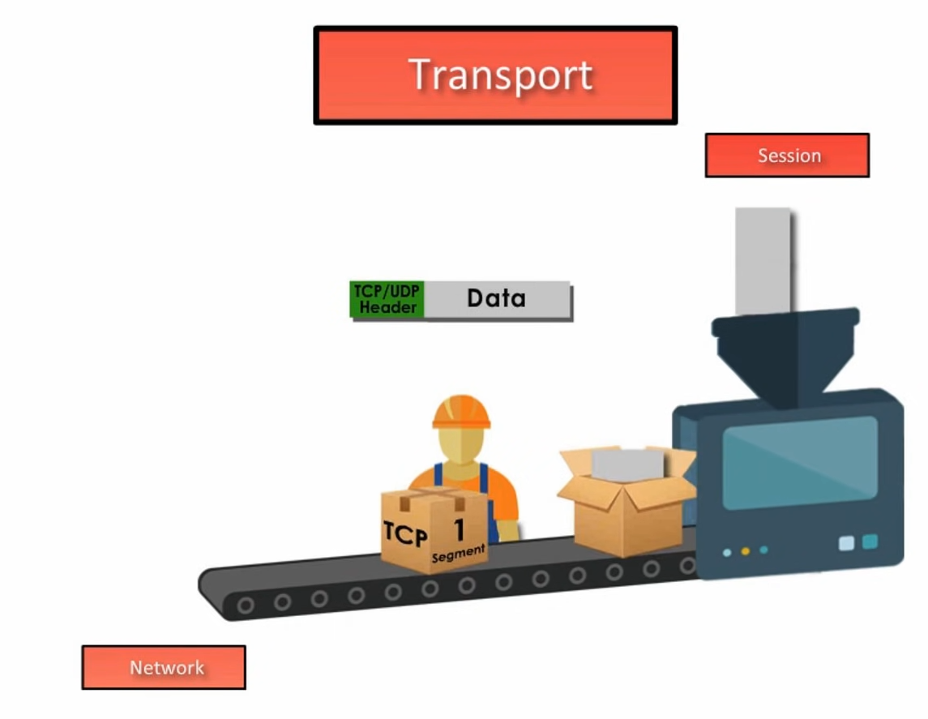
OSI Model Layers
Transport Layer
Application
Presentation
Session
Transport
Network
Data Link
Physical Layer

Slide 12
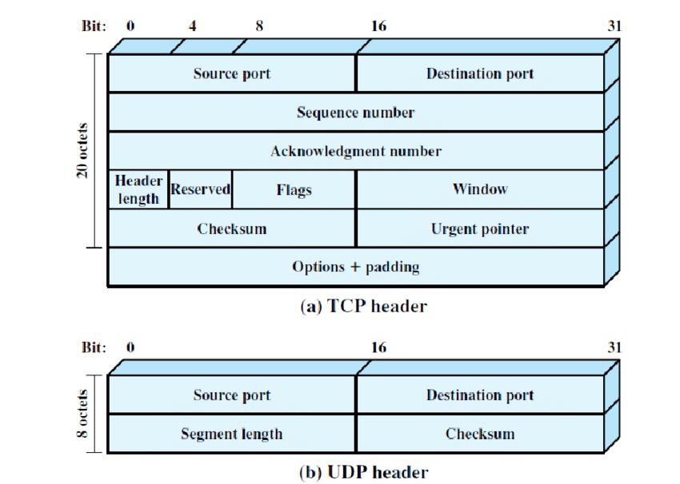
OSI Model Layers
Transport Layer
Application
Presentation
Session
Transport
Network
Data Link
Physical Layer
In Datagram, Data packets include a 16-bit value in the header, known as the checksum field.
TCP includes a checksum field for every data segment, which it evaluates for integrity during transmission.

Slide 13
 | Transmission Control Protocol (TCP) | User Datagram Protocol (UDP)
Nature of connectivity | TCP is connection-oriented. | UDP is a message-oriented and connectionless protocol.
Order of data transmission | TCP data packets have a sequencing number in the header to maintain the order of transmission. | UDP data packets arrive in no fixed order, and incorrect sequencing cannot be detected or corrected.
Speed | Slower | Faster
Multicast and broadcast | It is ideal for point-to-point transmission only, with confirmation of receipt. | It is suitable for broadcasting data packets to an entire group of endpoints, regardless of whether they listen.
Flow control | It utilizes flow control information to calibrate the pace of data transmission, to avoid overwhelming the recipient. | It does not use flow control and sends data at a rate suitable for the originating server.
Congestion control | It implements congestion avoidance algorithms to prevent data packets from getting lost in a congested network. | It cannot control network congestion and drops packets if too much traffic is on the pathway.
Reliability | TCP’s most significant advantage is that it is highly reliable. | Its architecture is designed in a manner that makes it inherently unreliable.
Application | It is suitable for use cases where data integrity, including images, web pages, data files, etc. matters more than transmission speed. | It is ideal for live data transmission (e.g., media), where transmission is so fast that a few dropped packets do not matter.

Slide 14
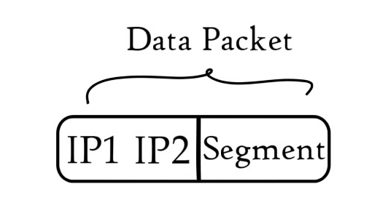
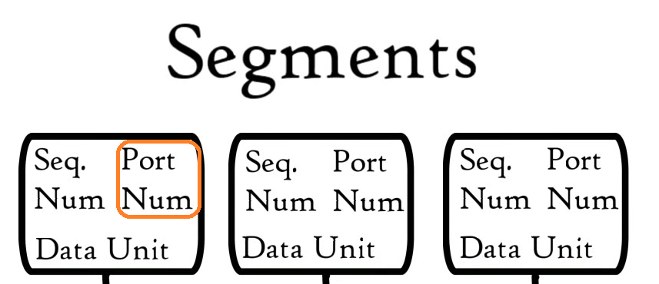
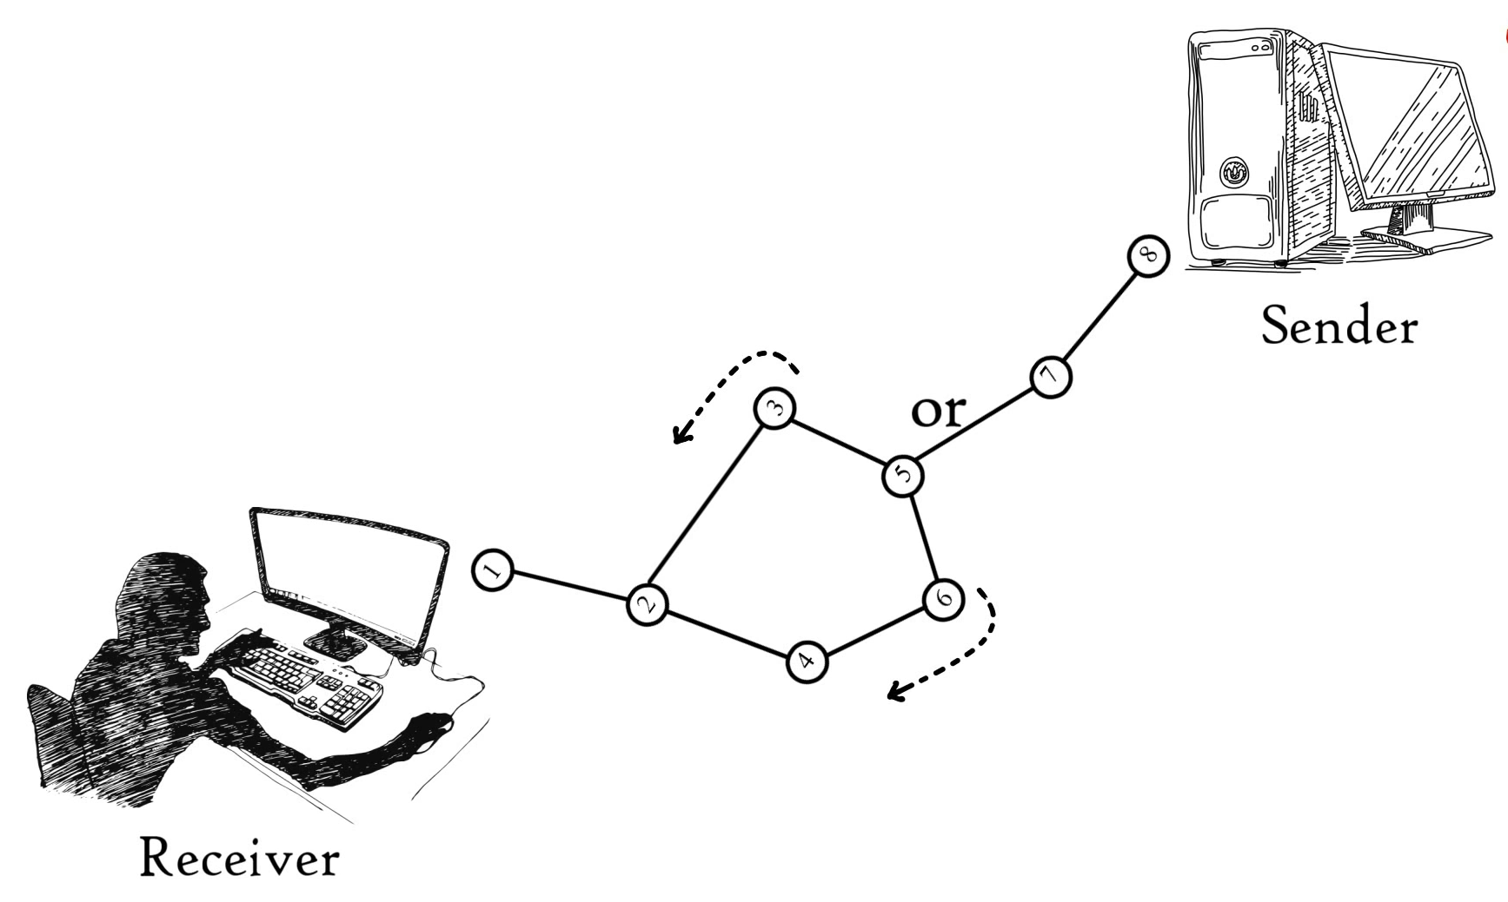
OSI Model Layers
Network Layer: The network layer has two main functions.
The segments received from the Transport layer are further processed to form the Packets.
The other is routing packets by discovering the best path across a physical network. The network layer uses network addresses (typically Internet Protocol, IP addresses) to route packets to a destination node.
Application
Presentation
Session
Transport
Network
Data Link
Physical Layer

Slide 15
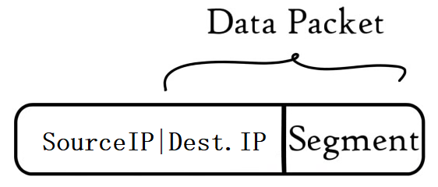
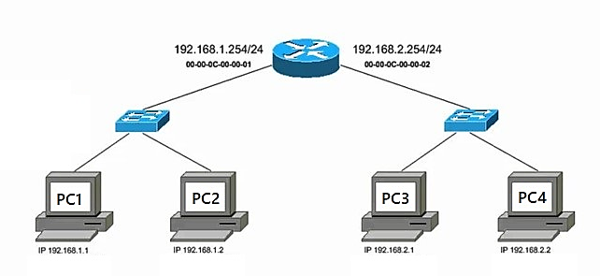
OSI Model Layers
Network Layer:
The network layer uses network addresses (typically Internet Protocol, IP addresses) to route packets to a destination node.
Application
Presentation
Session
Transport
Network
Data Link
Physical Layer
Destination

Slide 16
OSI Model Layers
Data Link Layer:
The data link layer is very similar to the network layer, except the data link layer facilitates data transfer between two devices on the SAME network.
Application
Presentation
Session
Transport
Network
Data Link
Physical Layer

Slide 17
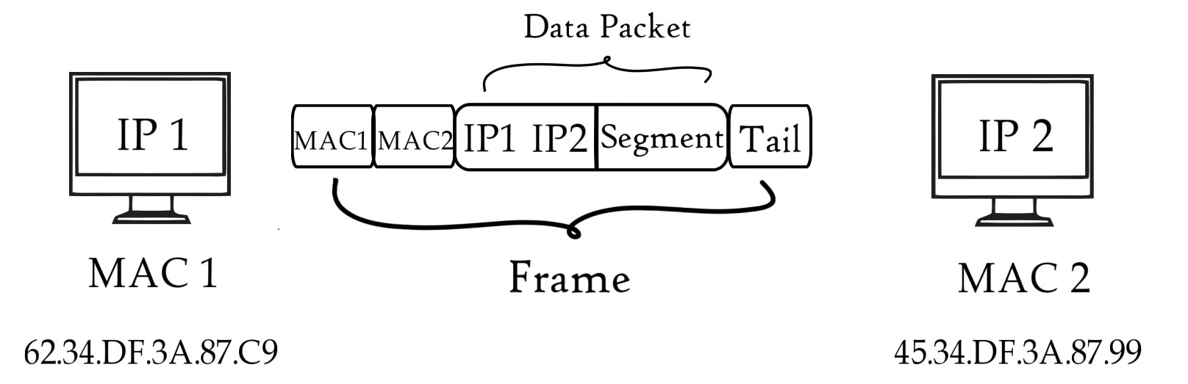
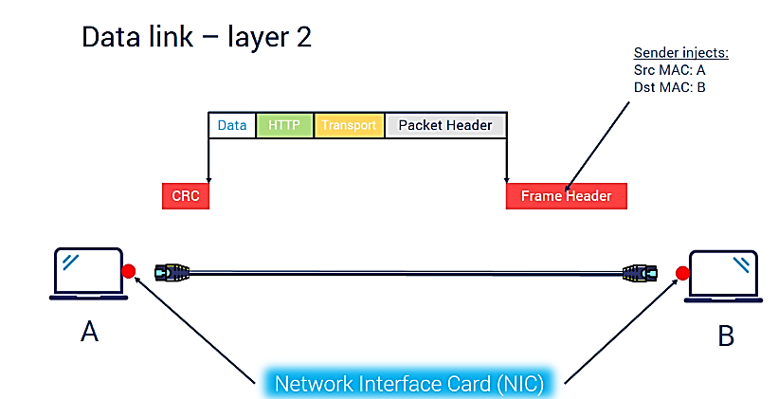
OSI Model Layers
Data Link Layer:
The data link layer takes packets from the network layer and breaks them into smaller pieces called frames. The data link layer is also responsible for flow control and error control in intra-network communication (The transport layer only does flow control and error control for inter-network communications).
Application
Presentation
Session
Transport
Network
Data Link
Physical Layer

Slide 18
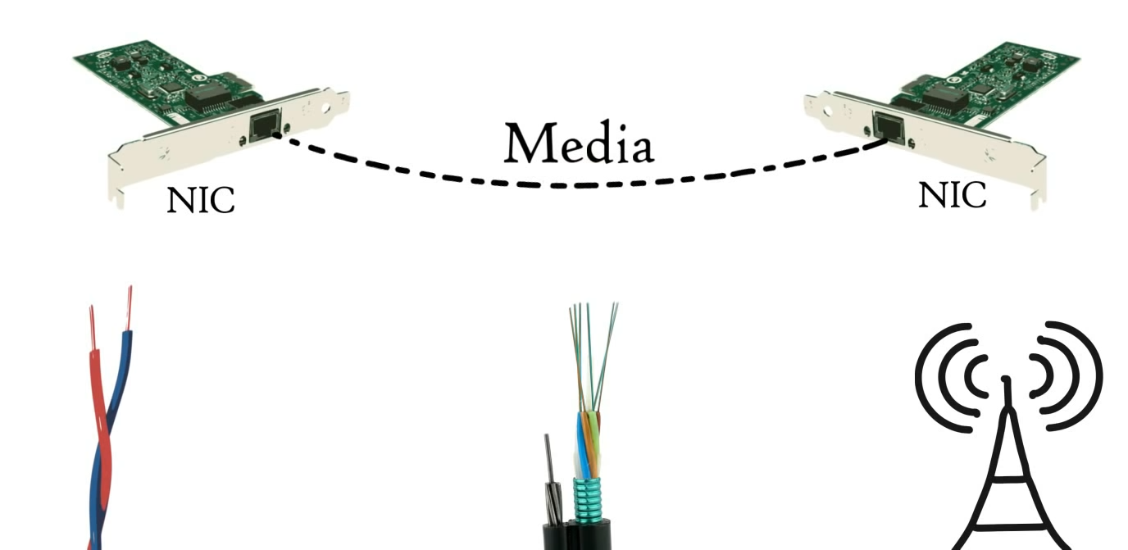
OSI Model Layers
Physical Layer:
This level establishes the relationship between a device and a physical transmission medium.
It defines the connector, the electrical cable, or wireless technology connecting the devices, and is responsible for the transmission of the raw data, which is simply a series of 0s and 1s while taking care of bit rate control.
Application
Presentation
Session
Transport
Network
Data Link
Physical Layer

Slide 19
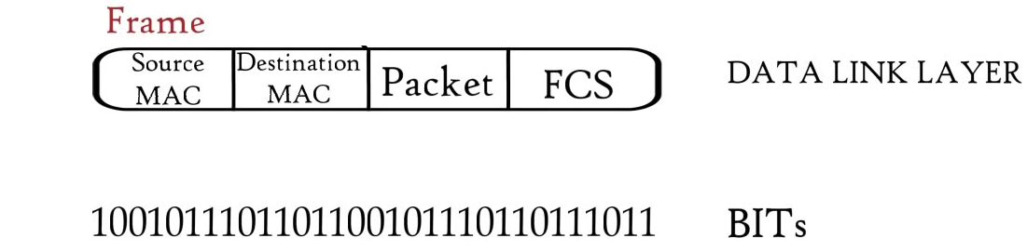
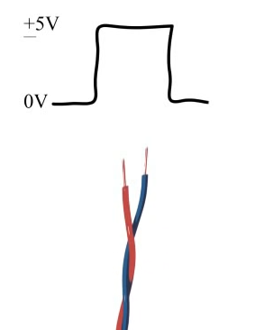
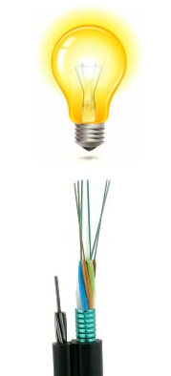
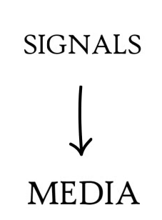

OSI Model Layers
Physical Layer:
It defines the connector, the electrical cable, or wireless technology connecting the devices, and is responsible for the transmission of the raw data, which is simply a series of 0s and 1s while taking care of bit rate control.
Application
Presentation
Session
Transport
Network
Data Link
Physical Layer

Slide 20
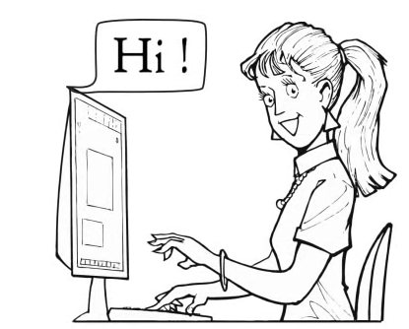
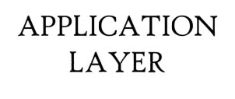
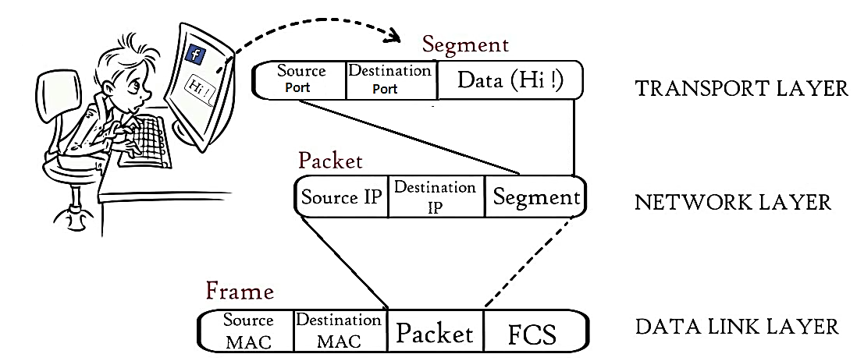
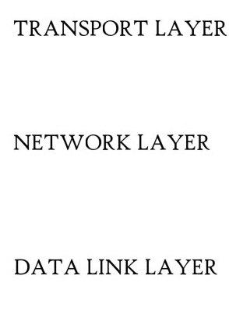
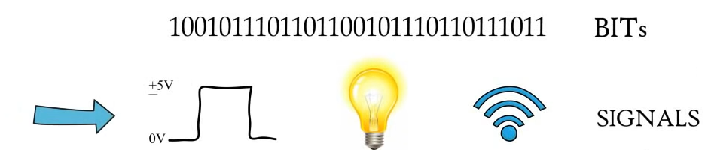


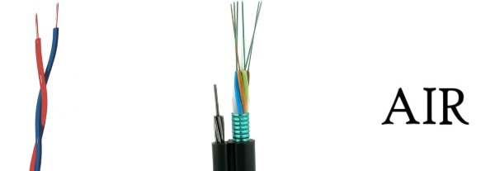
Application
APPLICATION, PRESENTATION, SESSION
Presentation
Session
Transport
Network
Data Link
Physical Layer

Slide 21
The modern Internet is not based on OSI, but on the simpler TCP/IP model.
However, the OSI 7-layer model is still widely used, as it helps visualize and communicate how networks operate and helps isolate and troubleshoot networking problems.

Slide 22
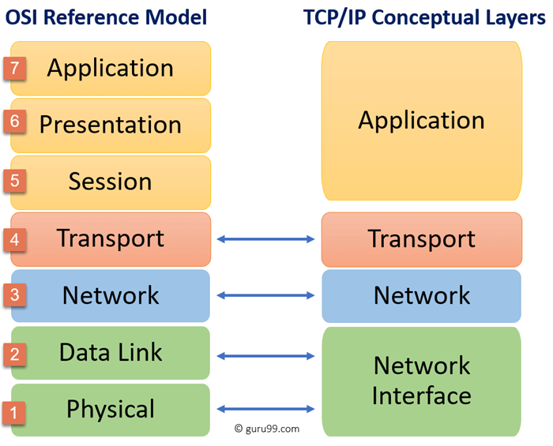

Slide 23
OSI Model | TCP/IP Model
It is developed by ISO (International Standard Organization) | It is developed by ARPANET (Advanced Research Project Agency Network).
OSI model provides a clear distinction between interfaces, services, and protocols. | TCP/IP doesn’t have any clear distinguishing points between services, interfaces, and protocols.
OSI refers to Open Systems Interconnection. | TCP refers to Transmission Control Protocol.
OSI uses the network layer to define routing standards and protocols. | TCP/IP uses only the Internet layer.
OSI layers have seven layers. | TCP/IP has four layers.
In the OSI model, the transport layer is only connection-oriented. | A layer of the TCP/IP model is both connection-oriented and connectionless.
In the OSI model, the data link layer and physical are separate layers. | In TCP, physical and data link are both combined as a single host-to-network layer.
Session and presentation layers are a part of the OSI model. | There is no session and presentation layer in the TCP model.
It is defined after the advent of the Internet. | It is defined before the advent of the internet.

Slide 24
TCP/IP model.
Application | HTTP FTP DNS | Application message
Transport | TCP UDP | TCP Segment/ UDP data frame
Network | IP ICM ARP | IP Packets
Data Link | Ethernet | Ethernet Frame
Physical | Ethernet

